Slide 1
Cherwell Portal and the Service Catalog
Mike Fuson
Solutions Architect, Consultant and Owner – Excalibur Data Systems

Slide 2
Have you ever wondered…..
How am I going to make it easy for my customers to find what they need in our service catalog?
Can I make the classifications different in the Portal, but still map correctly in the technician client?
Do I have to do only an A to Z Service Catalog in the Portal?
The Answer is…….You have a lot of options.
Let’s explore one of the possibilities together.

Slide 3
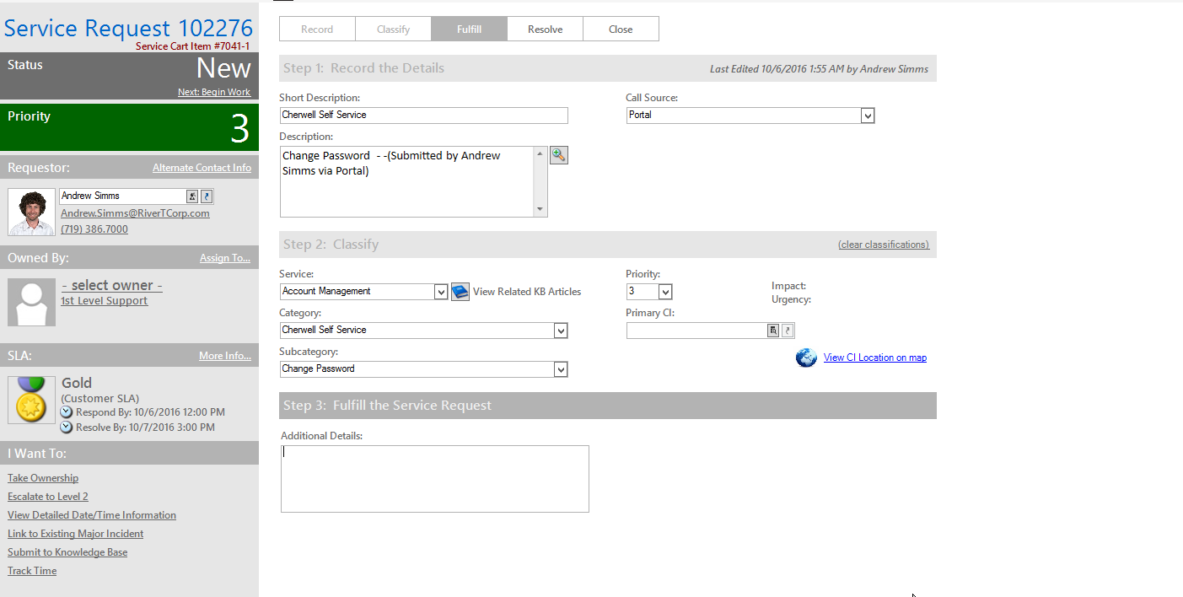
Cherwell Technician Classification Structure
Notes:
This is what many of your classification structures look like,
Service, Category, Subcategory. These are used to represent the Service Catalog in the Portal.

Slide 4
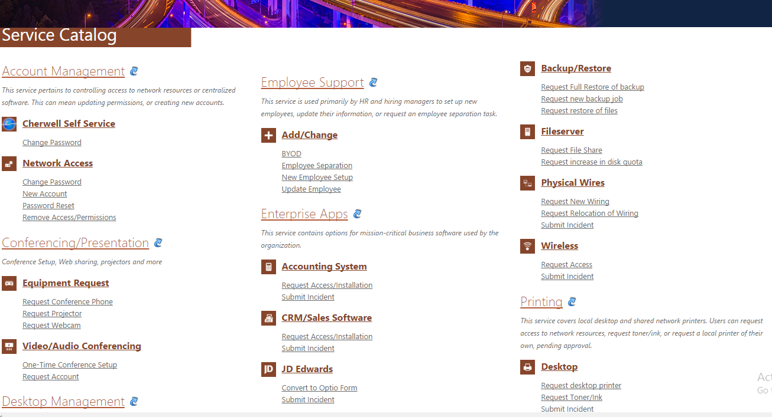
Default Service Catalog in the Portal
Notes:
The default Action Catalog in the Customer Portal is an A to Z action catalog

Slide 5
Break Down the Service Catalog?
Can we break the A to Z Service Catalog in smaller chunks or buckets?
Yes we can…it can be part of your portal design.
Can we still have an A to Z Service Catalog?
Absolutely….in addition to the buckets
Do the items (i.e. Service, Category, Subcategory) have to be the same in the Portal Action Catalog?
No! You can actually make them completely different and even group them differently?
But won’t that screw up how the Incident or Request comes in to the system?
Not at all. The Technician will see the proper classification and the data will be correct, but the customer will see something different in the portal.
How do we do this?

Slide 6
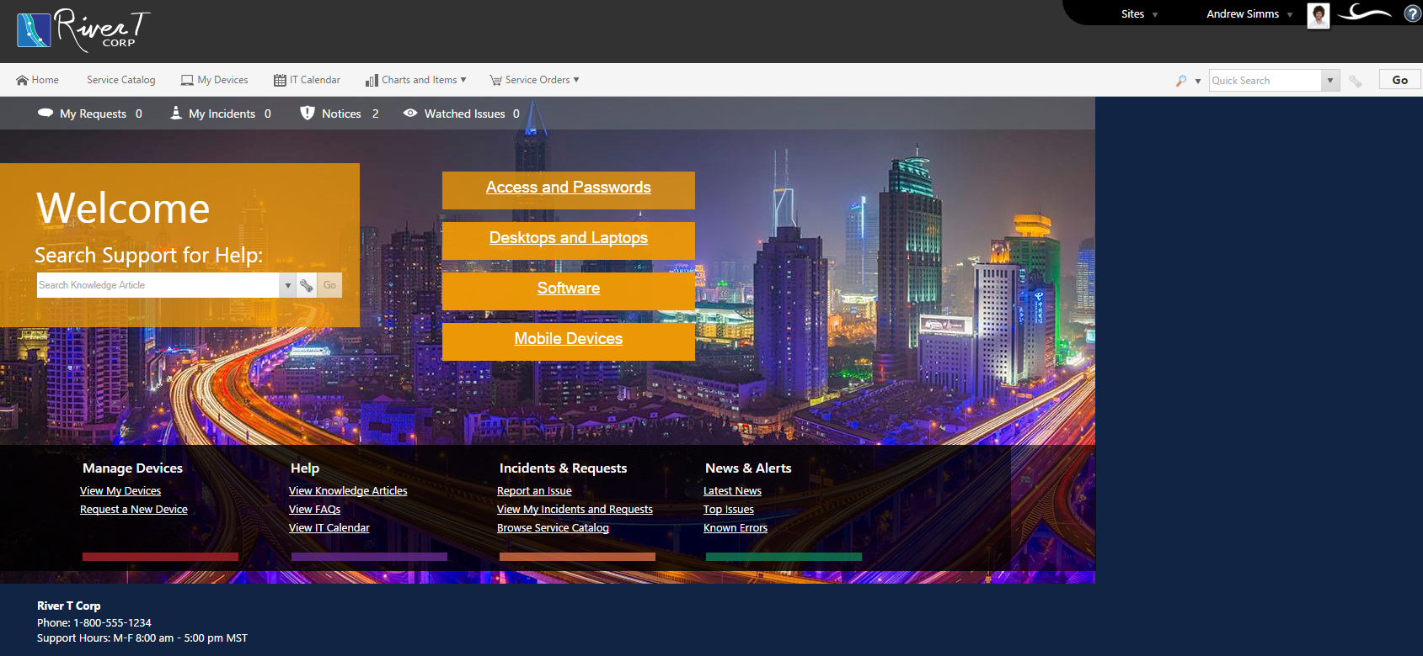
Presenting the Service Catalog in Chunks/Buckets

Slide 7
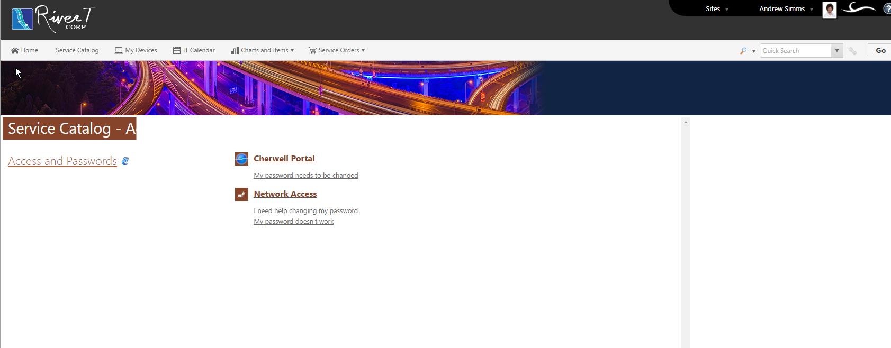
“Chunked Out” Action Catalog

Slide 8
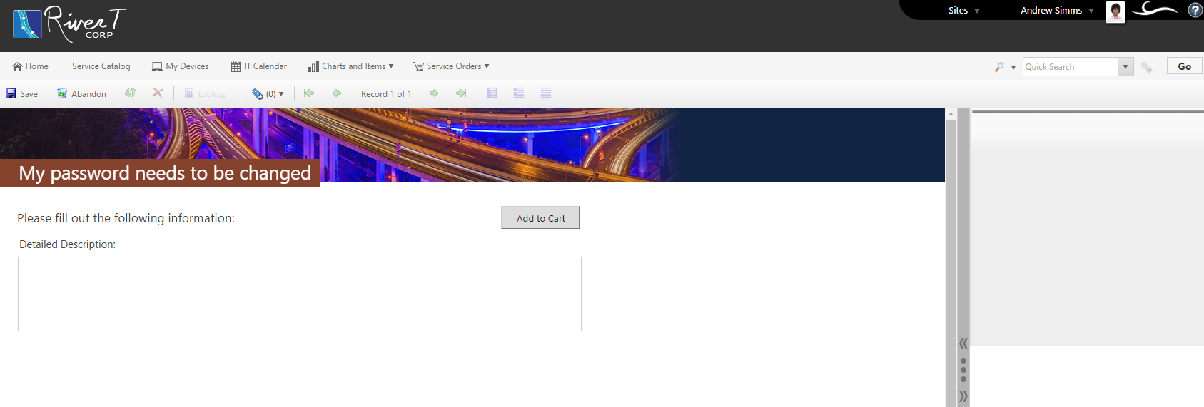
What the Customer Sees

Slide 9
What the Technician Sees

Slide 10
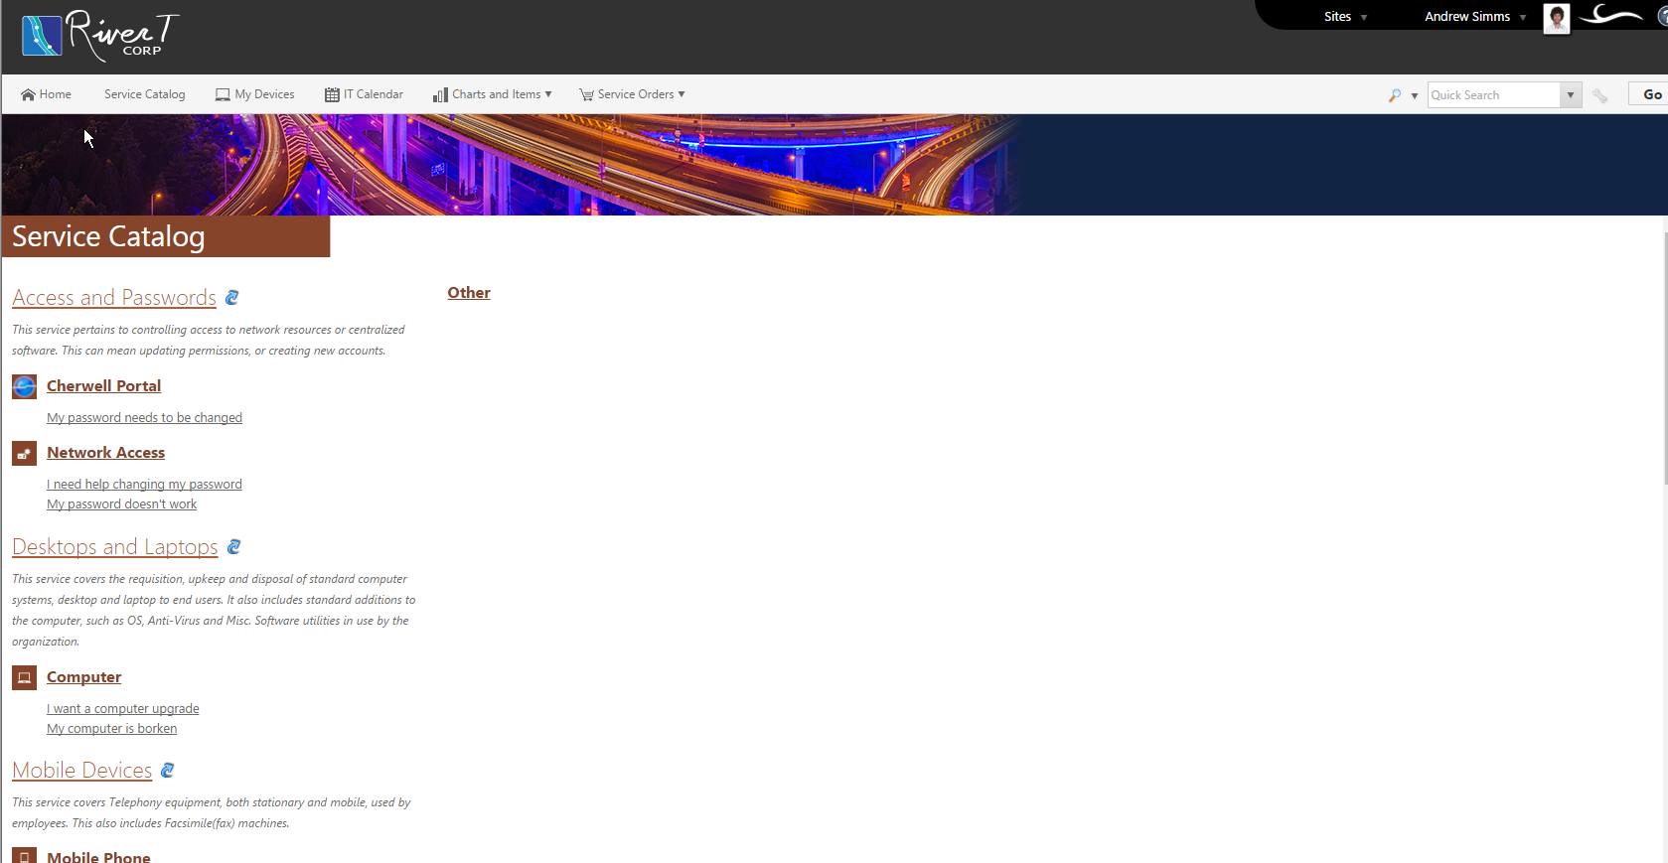
A-Z Service Catalog Still Works

Slide 11
How Did We Do That?
Changes to the Service, Category and Subcategory Tables
Add Portal Lookup Fields
Adjust Action Catalogs to look at the new values
Create Unique Action Catalogs for each of our “buckets”
Added these values to be auto populated when the action is run
Adjust Incident Portal View to Display these New Values
Let’s take a look

Slide 12
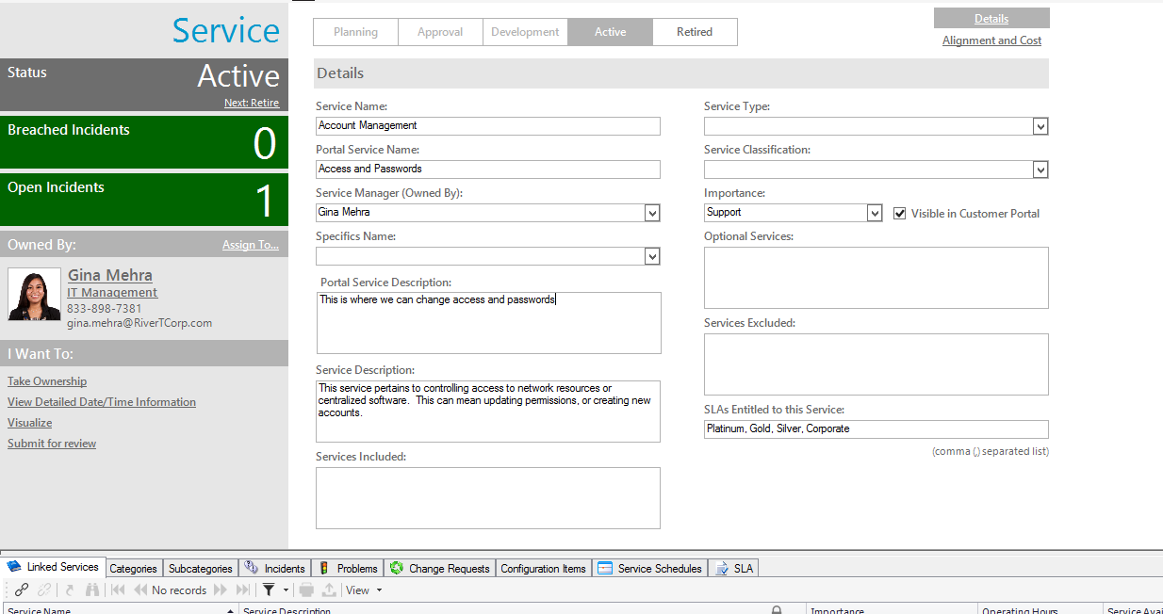
Adapt Service Object

Slide 13
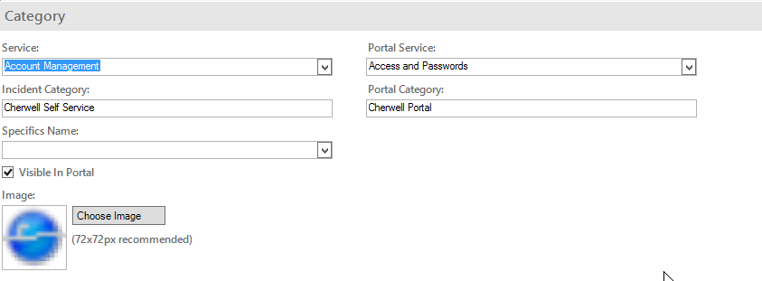
Adapt Incident Category Object

Slide 14
Adapt Incident Subcategory Object

Slide 15
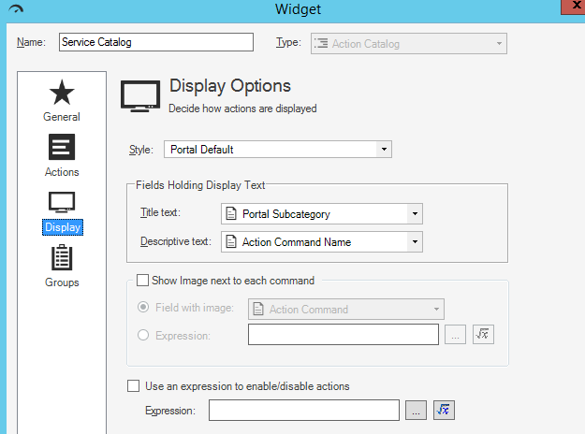
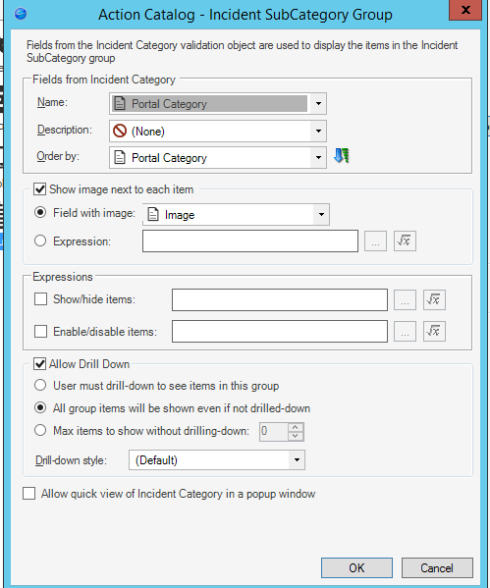
Adjust Action Catalog Display Settings

Slide 16
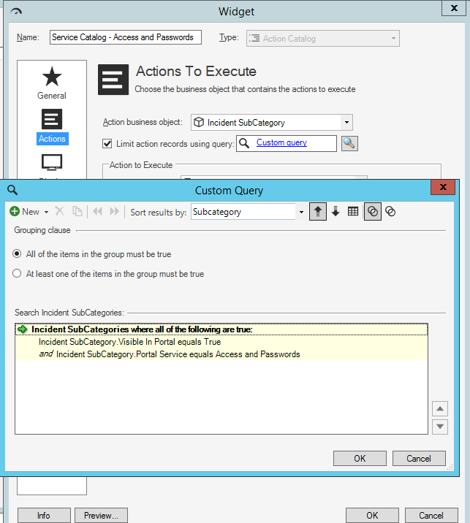
Create Custom Action Catalogs for the “Buckets”

Slide 17
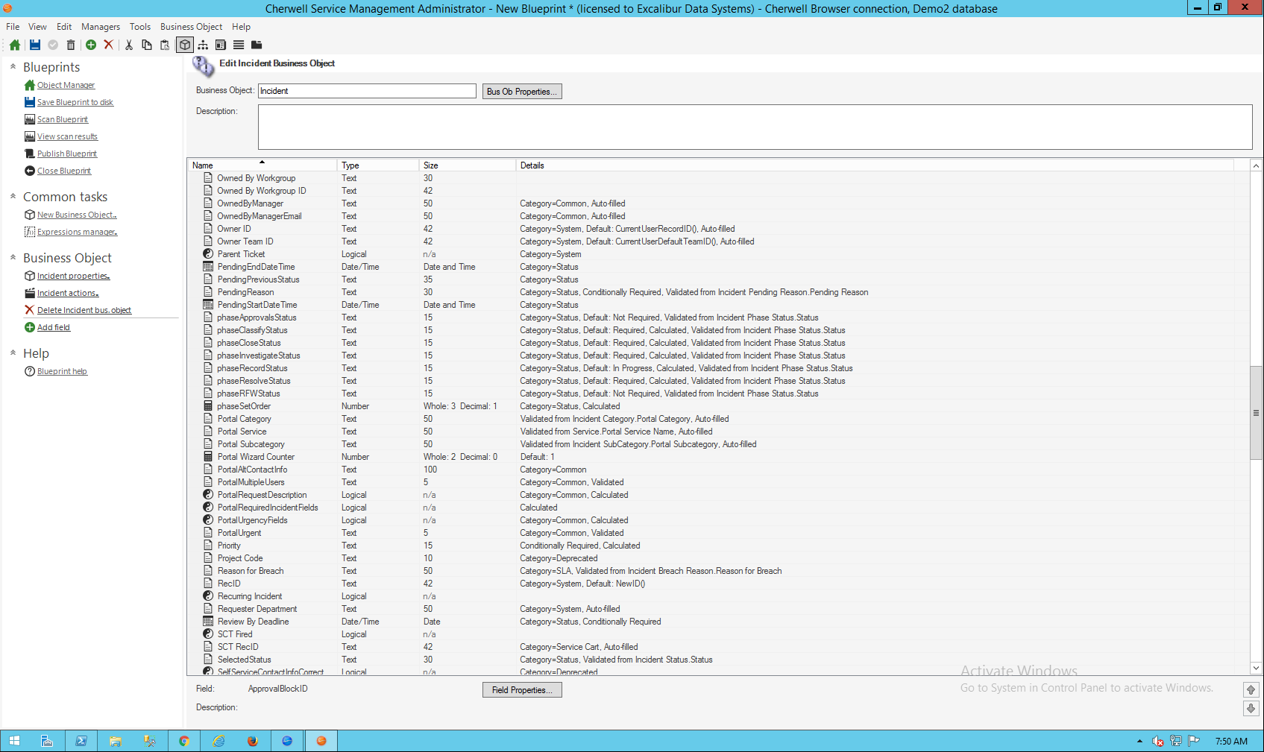
Auto populate Values

Slide 18
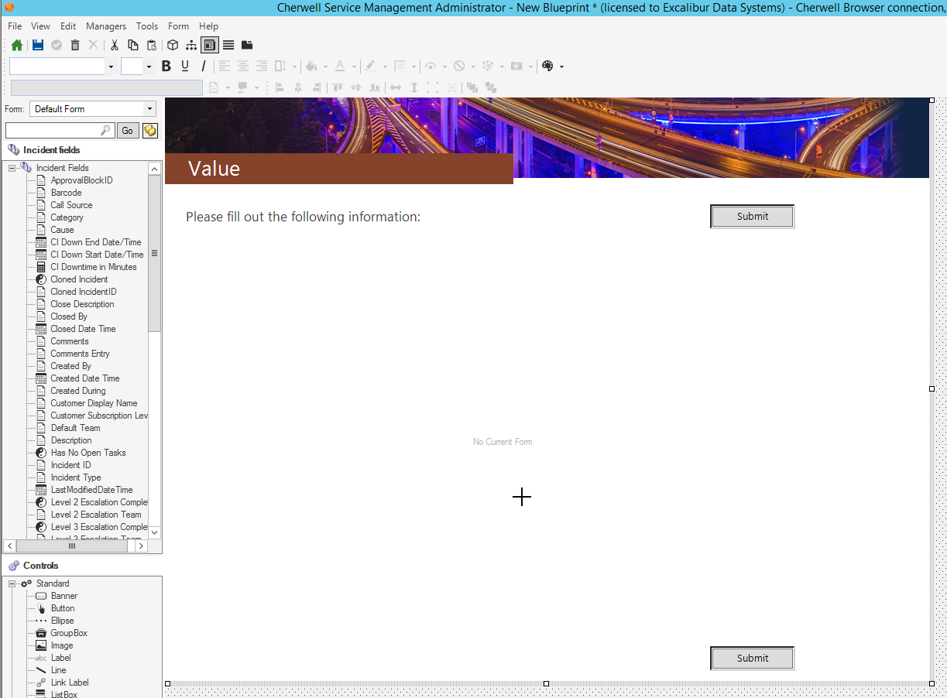
Adjust Portal Forms

Slide 19
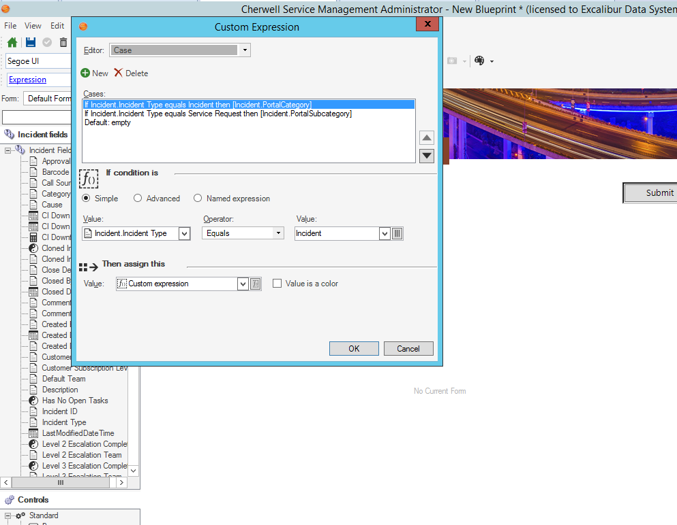
Adjust Portal Forms

Slide 20
What We Are NOT Changing
What we didn’t change was the action catalog One Step to create the Incident. It is still:
Populating Service, Category and Subcategory (We simply auto populated our Portal Values)
It still is following any routing or other rules you have set (via the One Step or Auto Populate)

Slide 21
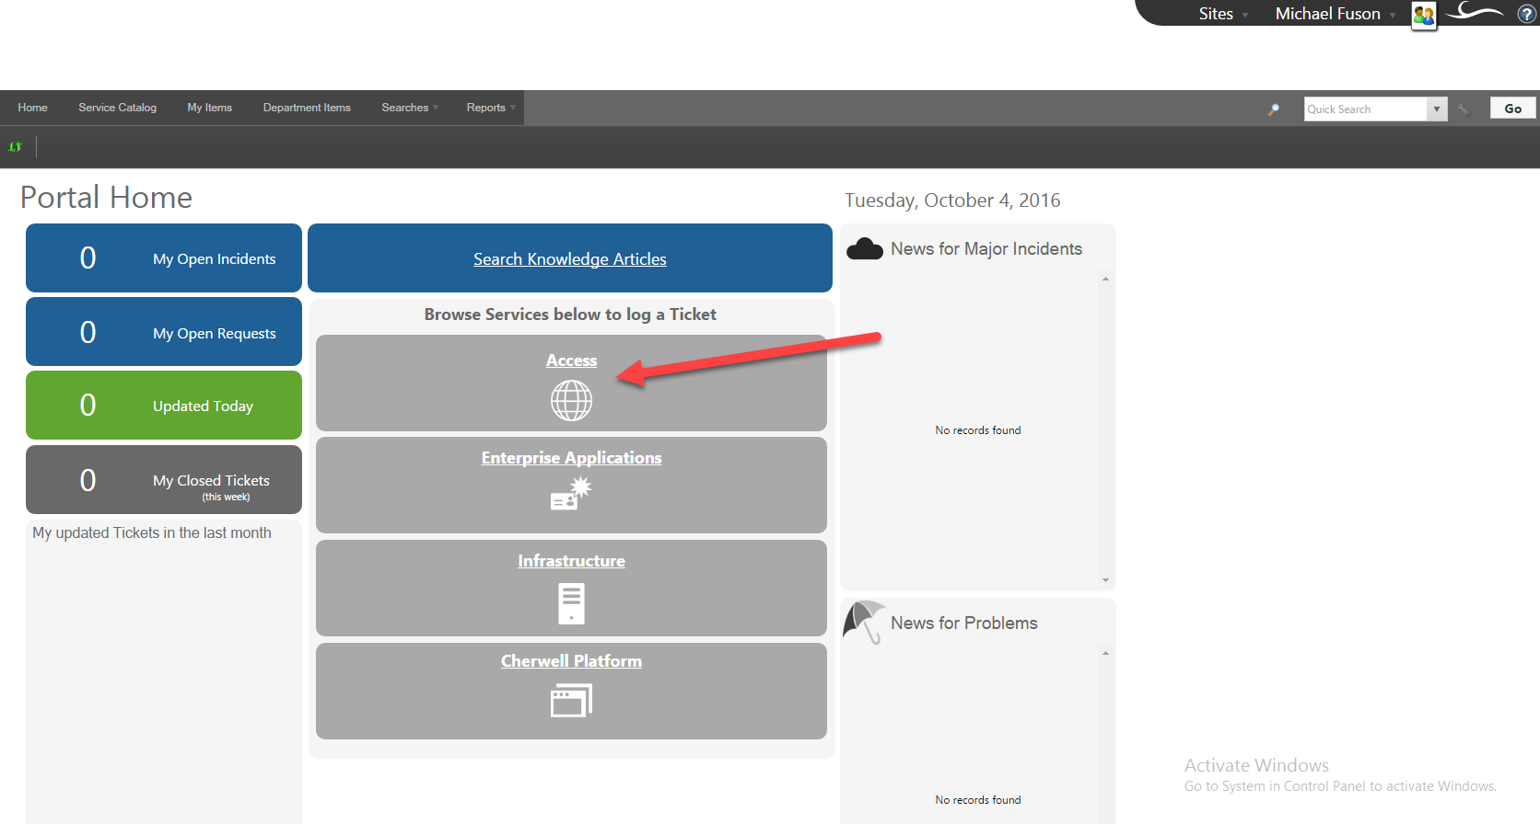
Another Example
Notes:
Similar bucketing with some other goodies on the main form.

Slide 22
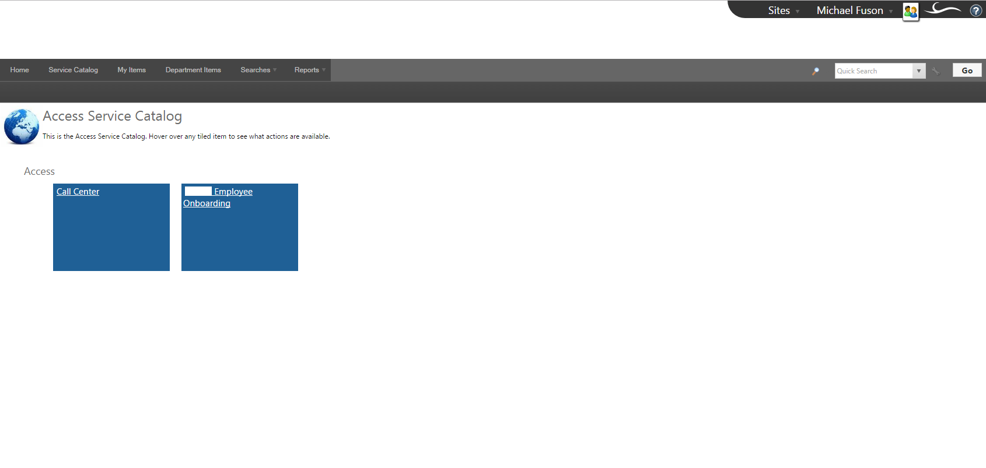
Another Example
Notes:
This is bringing up the action catalog directly.

Slide 23
Things to Consider for the Portal
Keeping the design clean, clean lines, flow, balance
How are we drilling down?
To a new dashboard (like the first design) or directly to the action catalog (like second design)
What information does the customer really need?
Do we want to drill down to other pages? Are there restrictions? Do we have the data to understand those restrictions?

Slide 24
Final Thoughts
Providing a Service Catalog in the Customer’s Language can be done, and it’s pretty easy……..
Because we are leveraging what is already there, we are getting the right data, routing and any other goodness you have added, but we have made it easy for the customer to find what they need and thereby tell us how we can help.
The Customer Portal can be a great resource. Consider your options, consider your audience. If you build it well they will come…….

