Slide 1
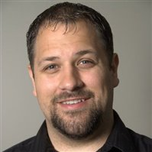
Cherwell + PowerShell = Powerful Workflow Automation
Robert Goguen works as the Change Manager and Senior IT Operations Analyst for Irving Oil Limited, which operates Canada’s largest oil refinery. An IT veteran with 20 years experience, half of his career has been in the IT learning development and performance field. Goguen has extensive experience in ITSM, and has been a member of the core ITIL implementation teams for Incident, Change, Problem and Configuration Management. As a subject matter expert in process implementation and development, he has been the lead on Cherwell Service Management development, administration, and operational strategy. Goguen has also overseen the development and deployment of training for Cherwell Service Management, HEAT, Axios, Remedy, SalesForce, Oracle BI, and SDLC.
Jeff Jones of Excalibur Data Systems is a veteran of multiple ITSM toolsets, just about every programming language known to man and way too much digital technology. He has spent the past 25+ years working with customers to improve their processes, integrate their data and when needed code things into submission. He has been working with Cherwell Service Management since its earliest days on the market and is a Cherwell consultant and instructor. When he isn’t working with a customer to make their Cherwell System leap tall building in a single bound, you’ll probably find him learning yet another programming language or elbows deep in a new technology he wants to add to his tool bag.

Slide 2
Cherwell + PowerShell = Powerful Workflow Automation
Robert Goguen
Jeff Jones
Service Management, Irving Oil Limited
Consultant, Excalibur Data Systems

Slide 3
Agenda
Welcome & Introduction
About this Session
PowerShell
What is PowerShell?
What can I do with PowerShell?
Why PowerShell?
Other scripting languages & non-Windows devices
How the magic happens
Executing Scripts
Passing Variables
Working with the Output
Enviroment Considerations (SaaS, On-Premise, O365)
Security & Privileges
Live Demo

Slide 4
Cherwell + PowerShell = Powerful Workflow Automation
Your Mission…..
Increase Value to the Business
Reduce Cost
Minimize Risk
Improve Service Offerings
No impact on Quality or Services
Notes:
Session Description:
IT departments are always looking for ways to automate and reduce the time it takes to perform day-to-day operational tasks such as creating user accounts, adding mailboxes and distribution lists, etc.. Each year countless hours are spent on this non-value added work, but does it have to be this way? What if Cherwell Service Management could give you back those hours, reduce human errors, and improve your MTTR? This session will provide a basic introduction on how you can use the powerful Cherwell Service Management workflow automation, in combination with Windows PowerShell, to give you limitless time savings potential in your day-to-day operations. If you can do it in PowerShell, Cherwell Service Management can automate it.
-------------------
Speaker Notes:
All organizations today are faced with the ever increasing challenge of how to best utilize resources in the most effective way possible, and this is especially the case within the area of Business Technology / IT. IT Groups worldwide are constantly juggling between increasing value to the business at the same time reducing cost, minimizing risk, improve service offerings, all without impacting the quality of the services delivered to customers.
Within this session our goal is to help you remove a few balls you need to juggle by demonstrating how Cherwell can reduce and in some cases eliminate large portions of non-value added IT tasks using Windows PowerShell. Please keep in mind this sessions primary focus will be on using Cherwell to execute PowerShell and help automate processes. Due to time limitations our session will not dive into how to script in PowerShell, however at the end of the presentation we will have resources available to everyone that will help you get started if you are unfamiliar with PowerShell or want to learn more.

Slide 5
PowerShell
What is PowerShell?
PowerShell is an automation platform and scripting language for Windows and Windows Server that allows you to simplify the management of your systems. Unlike other text-based shells, PowerShell harnesses the power of the .NET Framework, providing rich objects and a massive set of built-in functionality for taking control of your Windows environments (Source: MSDN)
Why PowerShell?
Most Microsoft Systems are managed using PowerShell. It is Microsoft’s go-forward technology that will be used to manage all products in the future. (Currently on version 5.0)
Notes:
What is PowerShell?
PowerShell is an automation platform and scripting language for Windows and Windows Server that allows you to simplify the management of your systems. Unlike other text-based shells, PowerShell harnesses the power of the .NET Framework, providing rich objects and a massive set of built-in functionality for taking control of your Windows environments. (Source MSDN)
Microsoft’s intent with PowerShell was to provide a replacement for the existing command line that exist in windows today, that provides a configuration management framework with an associated object based scripting language built upon the .NET Framework.
Why PowerShell?
This is Microsoft’s preferred configuration platform going forward. Most MS products that exist today such as Microsoft Exchange, System Center Configuration Manager (SCCM), Microsoft SharePoint, Microsoft SQL, Windows Server, Windows 7 and up, O365 etc. All use PowerShell as a configuration platform. In fact, the administration tools for the front end of these systems are simply GUI’s sitting on top of PowerShell such as the Exchange Management Console (EMC) / Exchange Admin Center (EAC).

Slide 6
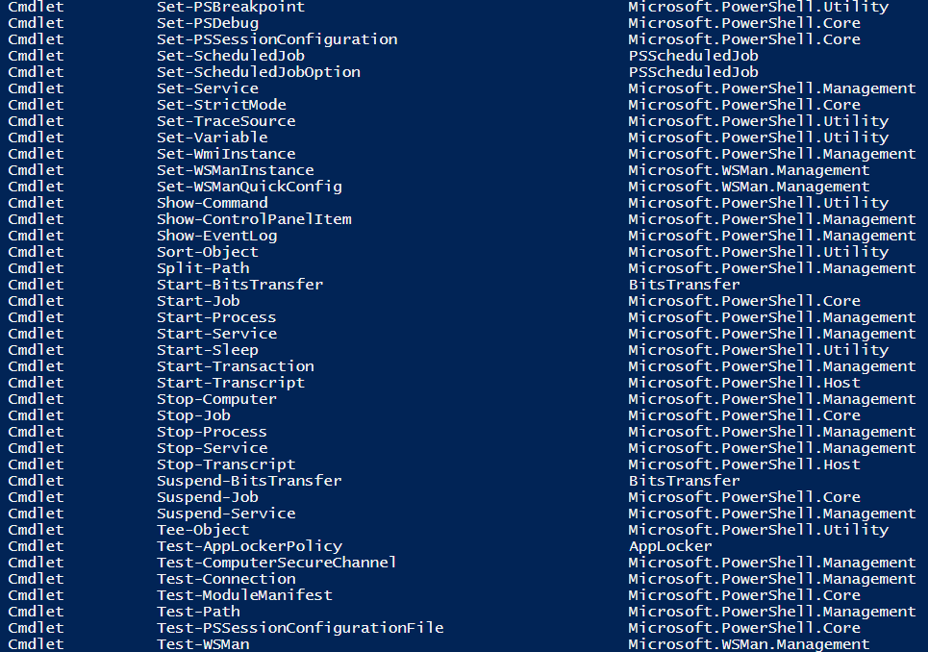
PowerShell
What can I do with PowerShell?
Just About Anything!
100’s of Cmdlet’s, Functions and 1000’s of Parameters
Notes:
What can you do with PowerShell?
Just About Anything!
PowerShell has 100’s of cmdlet’s, functions and 1000’s of parameters that you can use to configure and manage your environment. Microsoft is continuing to make more and more server functions command-line-only, settings and parameters that are only accessible using PowerShell.

Slide 7
Other scripting languages & non-Windows devices
What if I have to use a different scripting language?
This technique is equally effective for other scripting language on Windows operating systems
What if I need to script for a non-Windows system or device?
Use PowerShell’s new SSH features to run a remote script via SSH in whatever scripting language the system or device requires.
Notes:
This technique will work just as effectively for other scripting languages on Windows, but since Cherwell’s server components and desktop rich client components are only available for Windows it is slightly more difficult to script for other environments. A common technique for this is to use SSH to run a remote script via a third party tool such as PuTTY or, in the latest versions, PowerShell’s SSH support.

Slide 8
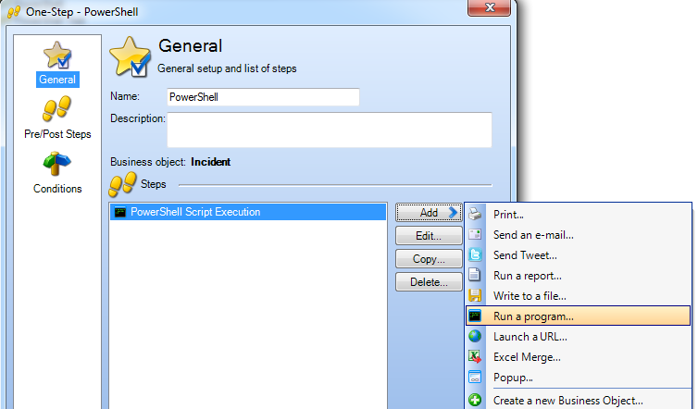
How the Magic Happens – Executing Scripts
Notes:
To executing a PowerShell script that is part of a process flow can easily be accomplished by using a one-step. Within the One-Step you will want to select the “Run a Program” action. In this example we will be executing a script against the Incident object.

Slide 9
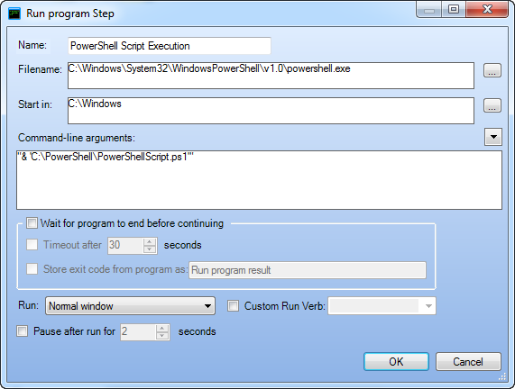
How the Magic Happens – Executing Scripts
Display Name of Action
Location of PowerShell Executable
(C:\Windows\System32\WindowsPowerShell\v1.0\powershell.exe)
Execution of Script with parameters
( “& ‘script location\scriptname.ps1’ ” )
Define how One-Step Interacts with Script Execution
Notes:
Defining the script execution:
Name: This is the display name used within the One-Step
FileName: The location of PowerShell. The default is: (:\Windows\System32\WindowsPowerShell\v1.0\powershell.exe
Command-Line Arguments: This is where you call out the script you are executing along with any additional arguments you would like to pass into the script. You can pass values into the script for consumption.
One-Step Interaction Definition: This area is where you can define how the One-Step itself can interact with the execution of the script.
Wait for Program to End before Continuing: Select this check box to have the One-Step wait until the program finishes executing before continuing to the next Action.
Note: The next two options are only available if you select Wait for Program to End before Continuing.
Timeout after X Seconds: Select this check box to have the One-Step either wait until the program is finished executing or the specified number of seconds has passed.
Store Exit Code from Program: Select this check box to have CSM store the program’s return code for use in future One-Step Actions. Then, provide a name for the variable that will hold the return code. It is then available as a variable in the system.
Note: This is not required; however, in most cases, you want to store the program result so that you can do something with it (ex: Create a Journal that records the result).
Define how the program should run:
Run: In the drop-down, select the type of window to run the program in.
Normal Window: Select this option to have the program run in a normal size window
Minimized: Select this option to have the program run in a minimized window (shown in taskbar).
Maximized: Select this option to have the program run in a maximized window (fills entire computer screen).
With No Window: Select this option to have the program run without being shown in a window.
Custom Run Verb: Provide an additional parameter that tells the program how to run (if the program requires one).Note: Some common verbs are NEW, OPEN, EDIT, and PRINT. Consult your program’s documentation to find out what verbs are available. If the program makes its list of supported verbs available, they are displayed in the drop-down.
Pause after Run: Select this check box to have the One-Step pause for a few extra seconds after running the program before continuing to the next Action. Then, specify the number of seconds the One-Step should pause.

Slide 10
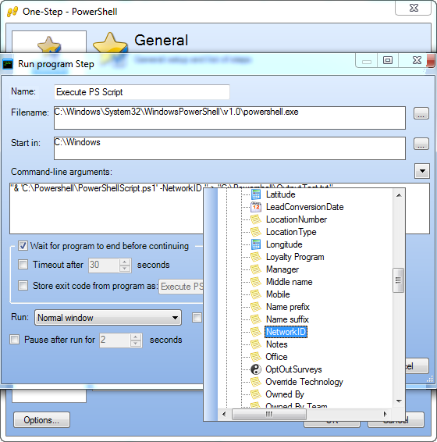
How the Magic Happens – Passing Variables
“& ‘Script Location’ –Parameter1 Value”
Notes:
You can pass named variables into the PowerShell script via the command line argument.

Slide 11
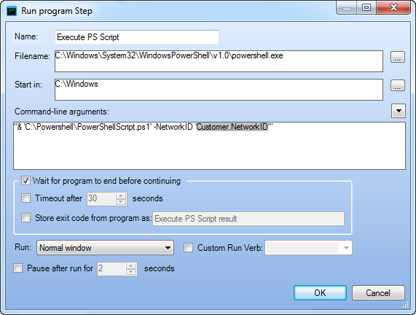
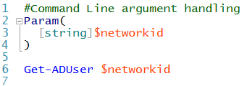
How the Magic Happens – Passing Variables
Notes:
You can pass named variables into the PowerShell script via the command line argument. You can pass as many variables into the script as want, and have the script use this information. Particularly useful for setting up a new user account, mailbox or distribution group in Active Directory.

Slide 12
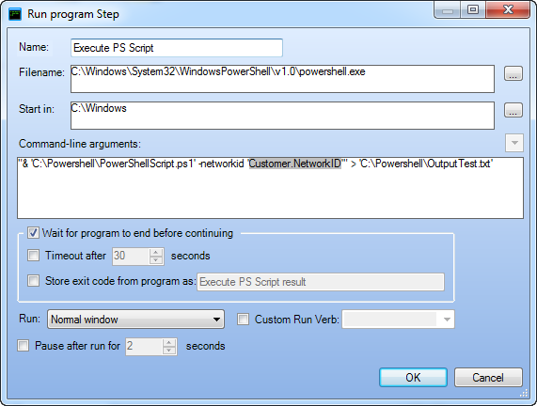
How the Magic Happens – Working with Output
> “<location>\Filename.txt”
Notes:
If your script has output that you need, you can import the output from your script back into Cherwell. To do this you first need to add to your command line argument by directing any output your script has into a file. It is very important when working with Output files you will want to check “Wait for program to end before continuing”. This will ensure that other steps within your one-step wait for the script to complete before executing. This is particularly important when your script has an output you need to import back into Cherwell, as you will want the script to complete before attempting to import the data.

Slide 13
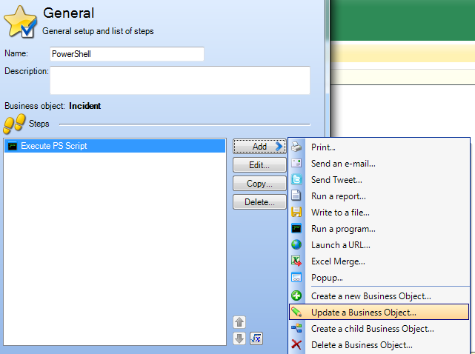
How the Magic Happens – Working with Output
Notes:
After the script runs, we will need to import the data from any output produced by the script. You can store this information either in a field or variable. To accomplish this add an additional step to your one-step. In our example we will update the description field on the incident object.

Slide 14
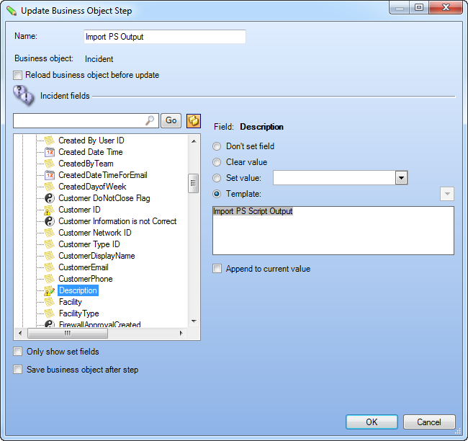
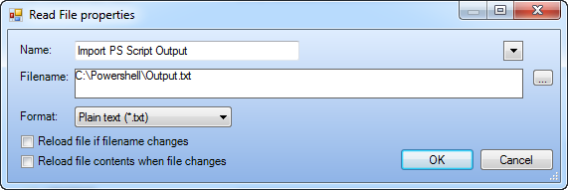
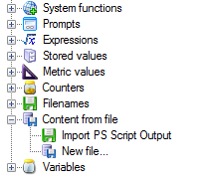
How the Magic Happens – Working with Output
Notes:
Read contents from the output file back into the business object by selecting “Content form file”. Point this to the output file and it will read the contents of the file back into Cherwell. Visibility is key, so any output files produced will need to be accessible.

Slide 15
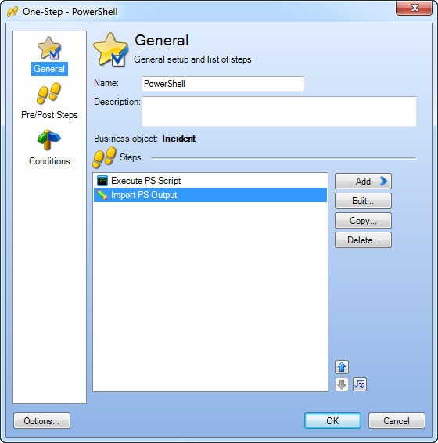
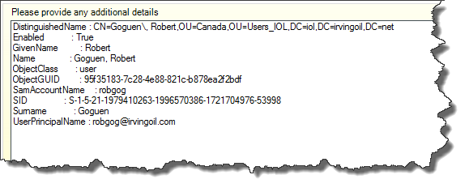
How the Magic Happens – Working with Output
Notes:
Once the One-Step is executed, the PowerShell script will run and output its results into a file. The next step in the One-Step will import the information from the file and update a field within the ticket. In this example, the results of running the Get-ADUser cmdlet are stored in the description field on the incident ticket.

Slide 16
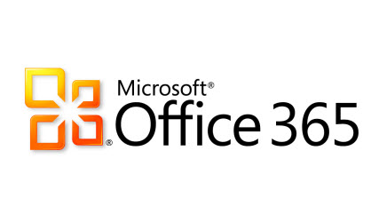
How the Magic Happens- Environment Considerations
On-Prem
SAAS
The Key is Visibility
Notes:
Enviroment Considerations (SaaS, On-Prem, O365)
There are some Enviroment challenges when working with SaaS environments and executing PowerShell scripts for automation. Visibility is the key to allow everything to work smoothly.
Scripts and execution of PowerShell scripts are stored and executed locally. If you are on Cherwell SaaS, you will need to have a VPN in order for the SAAS scheduler to execute scripts within your environment. However, local schedulers and rich clients can execute scripts as long as there is visibility to the scripts from the location of execution.
Connectivity with SaaS/Cloud based environments such as O365 is possible, as O365 allows you to execute PowerShell commands remotely. The challenge is passing authentication credentials to the cloud without human intervention to create true automation. One solution is to use an encrypted credentials file, which can be generated by a PowerShell script . We have included the script to accomplish this as part of the script pack on a resource page we have setup for this session. The link to the resource page is on a later slide.

Slide 17
How the Magic Happens – Security & Privileges
Keep in mind that these scripts run in the security context of the user executing them.
This means that for users executing the One-Steps through the rich client the script will execute in their security context.
For scheduled jobs they run in the security context of the service account used to run the Cherwell Scheduling Server.
Make sure the scripts don’t require more security privileges than the user can provide.
Notes:
Security & Privileges

Slide 19
Additional Resources
Our Presentation Resource Website
http://www.excaliburdata.com/resources/
Microsoft PowerShell for O365 Website
http://powershell.office.com/
MSDN PowerShell Gallery
https://msdn.microsoft.com/powershell
Notes:
Presentation Resource Website contains sample scripts, the presentation material, live demo recording and reference material.

Slide 20
Any Questions?
Notes:
Q&A Session

