Slide 1
Consultant, Excalibur Data Systems, Inc.
Jeff Jones
Automating Cherwell User, Team and Team Membership Creation From Active Directory

Slide 2
Automating Cherwell User, Team and Team Membership Creation From Active Directory
Jeff Jones of Excalibur Data Systems is a veteran of multiple ITSM toolsets, just about every programming language known to man and way too much digital technology. He has spent the past 25+ years working with customers to improve their processes, integrate their data and when needed code things into submission. He has been working with Cherwell Service Management since its earliest days on the market and is a Cherwell consultant and instructor. When he isn’t working with a customer to make their Cherwell System leap tall building in a single bound, you’ll probably find him learning yet another programming language or elbows deep in a new technology he wants to add to his tool bag.

Slide 3
Agenda
Welcome & Introduction
Potential Automation Methods
Users & Teams in Cherwell
Cherwell Objects & Backend Tables
How They Fit Together
A Deeper Look
Teams
Users & Authentications
Team Memberships
Security Groups
Automating It
Active Directory: The Source of Truth
Preparing the Cherwell System
Avoiding Conflicts with Manually Entered Data
Processing the Import
I Want This
Q&A

Slide 4
Potential Automation Methods
SQL Scripting/Triggers
SQL Service Integration Services
Web Services
PowerShell
One-Steps
Our Approach
Use Cherwell’s Web Services via PowerShell to get the data staged into Cherwell Objects
Use One-Steps to create the appropriate records for Teams, Users and Team Memberships
Wrap this all up in a single One-Step called via the Cherwell Scheduler to perform the entire process

Slide 5
Users & Teams in Cherwell
Cherwell Backend Tables
TrebuchetSecGroups – Holds security group definitions
TrebuchetDefs – Holds team definitions
TrebuchetAuth – Holds user and customer authentication records
TrebuchetTeamMember – Holds user and customer team membership information
Cherwell Objects
User Info – Holds the client accessible information about a user
Team Info – Holds the client accessible information about a team, v6.0 and later only

Slide 6
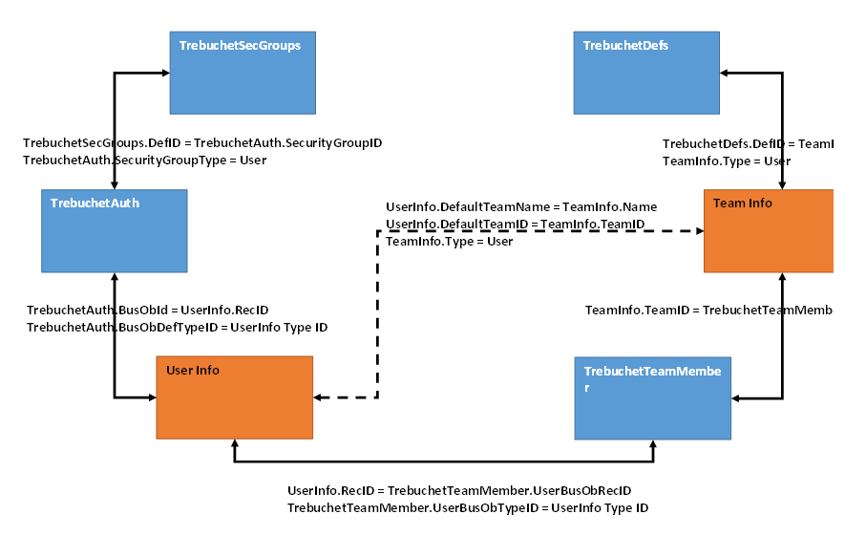
Users & Teams in Cherwell
How They Fit Together

Slide 7
A Deeper Look - Teams
TrebuchetDefs
TrebuchetDefs contains the definition of almost every object the user interacts with in Cherwell, one of these is the definition of a team. The definition is stored as XML in the DefDetails field and looks like this:
<Trebuchet>
<TeamDef ID="93d5f985f19b1e6dbb50f24942866662053c13e88f"
Name="IT Management" Version="1.0" SubType=""
Scope="Core" Culture="Invariant" View="(None)"
TeamType="User">
<Alias />
<Description />
</TeamDef>
</Trebuchet>
TeamInfo
Fortunately with v6.0 Cherwell introduced the TeamInfo object, which is directly tied to the backend definition. There are several interesting fields available for our use:
TeamID – This contains the ID of the team that Cherwell uses internally
Name – This contains the Name of the team
Description – This contains a description of the team
Image – This points to an image displayed for the team
Type – This contains the team type , either User or CustomerWorkgroup
EmailAlias – Contains the email address to send messages to
To create a new team you just create a TeamInfo record filling in the Name and Type and Cherwell will create the definition for you.

Slide 8
A Deeper Look – Users & Authentications
Users are split into two parts in the Cherwell backend, the authentication details stored in TrebuchetAuth and the User details stored in UserInfo. To correctly create a user both of these pieces must be created.
Starting with UserInfo, these are some important fields:
RecID – Contains the system generated record id.
Full Name (and associated name fields) – Contains the user’s name
Default Team Name – contains the name the user’s default team
Default Team ID – contains the ID of the above
SAMAccountName – contains the user’s network ID
System_LDAPPath – contains the user’s LDAP distinguished name
After the UserInfo record is constructed we need to create an authentication record in the TrebuchetAuth table. Here are a few important fields to set here:
WindowsIdentifier – Contains the user’s AD login id (domain\username)
SecurityGroupType – Will always be set to User
SecurityGroupID – Contains the DefID of the user’s security group
BusObDefTypeID – Contains the DefID of the UserInfo table
BusObID – Contains the RecID of the user’s UserInfo record
Note that we can only create AD/Windows accounts as we don’t know the hash function to create passwords for internal accounts, although with v8’s REST API there is now a web service call to set the password.

Slide 9
A Deeper Look – Team Memberships
Team Memberships in Cherwell are implemented as a simple join table that relates the UserInfo object to the TeamInfo (or more specifically the TrebuchetDefs) object in a many to many arrangement, with the addition of a single field to indicate if the user is a manger of the team or not. Here is what we need to set in the table:
TeamDefID – Contains the team’s TeamID from the TeamInfo table
UserBusObRecID – Contains the user’s RecID from the UserInfo table
UserBusObTypeID – Contains the ID for the UserInfo object
TeamMgr – Contains 1 if the user is a team manger, 0 otherwise

Slide 10
A Deeper Look – Security Groups
Security Groups are stored separately from all other definitions in Cherwell’s backend in a table named TrebuchetSecGroups. Similar to the team definitions stored in the TrebuchetDefs table the actual definition of a security group is stored as XML, but, unlike the simple XML of a team definition, the security group definition is extremely complicated and intertwined with other definitions.
Creating Security Groups outside of the standard Cherwell Administrator tool is not recommended and will not be covered in this session.
<Trebuchet>
<SecurityGroup ID="93373402da59635ba9e6164cf89364774a3a2bebb1" Name="Admin" Version="1.0" SubType="" Scope="Core" Culture="Invariant" View="(None)" Disabled="FALSE" DontAllowToRemove="TRUE" Admin="TRUE" DefaultSecurityGroup="FALSE" SecurityGroupType="User">
<LastModBy>CSDAdmin</LastModBy>
<LastModDateTime>2015-12-03T17:54:32</LastModDateTime>
<Alias />
<Description>Security group for system administrators. Typically, these Cherwell users can delete groups of records.</Description>
<StandardRightList DefaultRight="Yes,View,Add,Edit,Delete">
<StandardRight Name="Queues.SuspendQueueItems.Global" Right="Yes,View,Add,Edit,Delete" />
<StandardRight Name="OneStep.CanSetToRunUnderAnyGroup" Right="Yes" />
<StandardRight Name="Dashboards.Dashboards.Global" Right="Yes,View,Add,Edit,Delete" />
<StandardRight Name="Admin.SystemBlueprint.FieldDetails" Right="Yes,View,Add,Edit,Delete" />
<StandardRight Name="Reports.ReportStyles.Global" Right="Yes,View,Add,Edit,Delete" />
…

Slide 11
Automating It – Active Directory: The Source of Truth
Mapping Active Directory Objects to Cherwell Objects
Users are Users
Teams are AD Security Groups
Which Groups to pull in?
Team Memberships
Limitations with the built in LDAP import
Which Team is the Default?
Name based?
AD attribute based?
The first/last found?
Or just ignore it?
Cherwell Security Groups
Commonly Used AD Convention
User OU
John Smith
Security Group OU
CSM_SG_Admin
CSM_DEF_TEAM_ITSM Support
CSM_TEAM_ITSM Support
CSM_TEAM_IT Management
CSM_TEAM_ITSM Support
…

Slide 12
Automating It – Preparing the Cherwell System
Staging Tables
Exposing Backend Tables
External Data Connection
Exposing TrebuchetAuth
Exposing TrebuchetTeamMembers
ImportedUser
Related To UserInfo
Related To TrebuchetAuth
ImportedTeam
Related To TeamInfo
ImportedTeamMembership
Related To TeamMemberMapping
TeamMemberMapping
Related To UserInfo
Related To TeamInfo
Related To TrebuchetTeamMembers

Slide 13
Automating It – Avoiding Conflicts with Manually Entered Data
Invariably some users, teams and team memberships will need to be manually created and we need to make sure that our automated import doesn’t touch these items, and doesn’t duplicate these items. To facilitate this we add a marker field to the items which are automatically imported for the User and Team items and avoid those items if the marker is not set. For team memberships the Team Mapping structure is used to facilitate this since we cannot change the structure of the TrebuchetTeamMembers table itself.

Slide 14
Automating It – Preparing the Cherwell System
How It Fits Together
1. Import the Data via PowerShell
A. Connect To SOAP API
B. Read AD & Create User Objects
C. Read AD & Team Objects, if:
i. Security Group: update User Objects
ii. Default Team: update User Objects
iii. CSM Team: create Team Object
iv. CSM Team: Add Membership Objects
2. Create TeamInfos
3. Create UserInfos/TrebuchetAuths
4. Create Team Member Mappings
5. Create Team Memberships
6. Clean Up

Slide 15
I Want This
At the end of the Cherwell Global Conference 2016 a mApp will be available in the mApp Exchange on the community site with a basic implementation of this method to automate the creation of Users, Teams and Team Memberships in your Cherwell platform.

Slide 16
Any Questions?

